Slide 1
Workshop Topic #1
November 2013
Focus Applications

Slide 2

Applications
First Level Taxonomy
AMI/Metering
Distribution Automation
Substation Automation
Other – I have my ideas of “other”
Missing anything major??

Slide 3
Applications
Second Level Taxonomy
AMI/Metering
Just billing?
Or more frequent data pulls for things like demand response, distributed generation, variable billing, etc.
What are requirements?
Notes:
Avg of 1-2M per day for gatekeeper. Estimate 1kbps per read per meter.
So if you’re doing 15 min reads (assuming 1000 meters per colletor) you start to get into GB of data per month.

Slide 4
Applications
Second Level Taxonomy
Distribution Automation
CVR
Volt/VAR
Feeder Automation
Asset Health
Protection
Mobile Workforce
What are requirements? And then what are the requirements in the aggregate?

Slide 5
Applications
Second Level Taxonomy
Substation Automation
Automating IEDs/Apparatus in the yard (i.e. Voltage Regulator Controls)
Monitoring/Asset Health
Video Monitoring
Physical Security (access controls on gate or control house)
Mobile Workforce
What are the requirements? What are the requirements in the aggregate?

Slide 6
Applications
Second Level Taxonomy
Other Applications
Selling services to municipalities within your territory? Does this apply?
Gas and Water utility applications
Selling to others who need field area networking (i.e. oil and gas exploration, mining, industrial customers)
What are the requirements? What are the requirements in the aggregate?

Slide 7
Applications
Second Level Taxonomy
Are we missing anything?

Slide 8
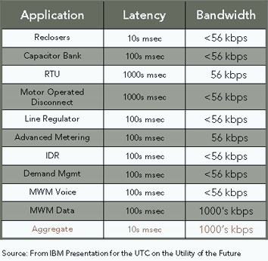
Reliable, high performance communication: key to modern grid operation, delivered by broadband mesh
Other applications representing higher traffic include
Substation video
PHEV integration
Mobile GIS
AVL
and more in the future

